Slide 1

Jupyter, Numpy, Pandas
Jupyter Notebooks & Markdown
Further Review of Python & Pandas
Matthew Morris
Git: Morrisdata
MatthewMorris.DA@gmail.com

Slide 2

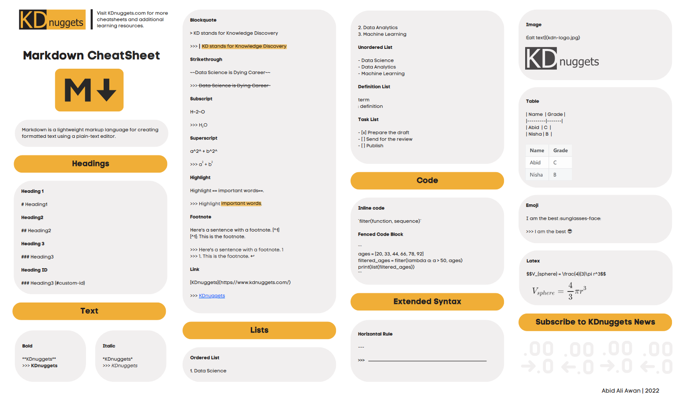
Jupyter Notebooks & Mark Down
http://localhost:8889/notebooks/03_ipython_notebook_tutorial.ipynb#

Slide 3

Terms
Data Frames
Data Frame- Structures data into a two-dimensional table of Columns and rows.
Data Table – Columns, and rows that contain specific values
Tables

Slide 4
Terms
DATA FRAME | DATA TABLE
Used to build tables and matrices | Used for complex data structures and big data
20x slower than a data table | Faster even then spark in many cases
Can work with structured or semi structured data | Is often an output of a Data Frame and works with modeled structured data.
Does not need a table | Dependent on a Data Frame or prepped organization

Slide 5
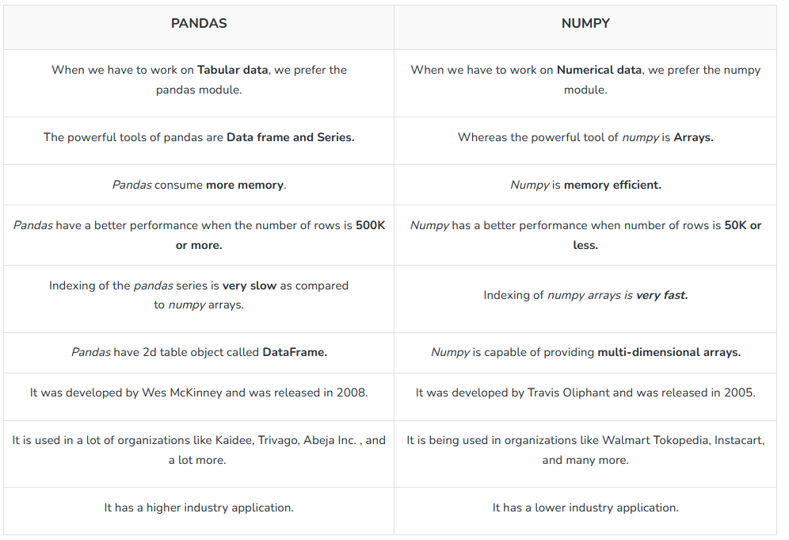
Pandas and Numpy

Slide 6
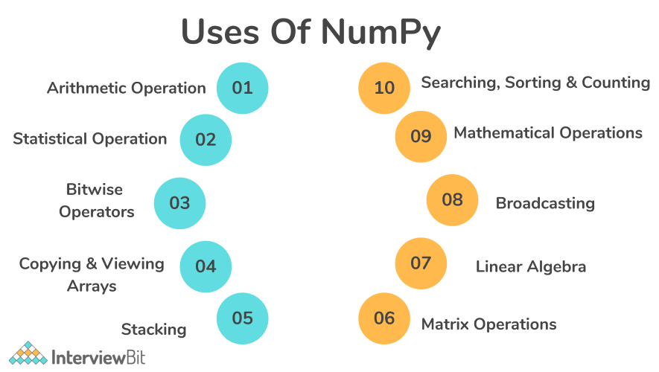
Basic Excel EDA

Slide 7
Terms
Indexing numpy https://www.pythonlikeyoumeanit.com/Module3_IntroducingNumpy/BasicIndexing.html

Slide 8
In your own words what is the difference numpy and pandas?
Mention the different types of Data Structures in Pandas
What are the significant features of the pandas Library?
Define Series in Pandas?
What are the different ways in which a series can be created?
How do you read Text Files with Pandas?
Notes:
DML - Data Manipulation Language

Slide 9
Tasks
Use Chipotle data to rebuild Pandas lecture
Leverage outputs to support Chipotle Project
Matthew Morris
Git: Morrisdata
MatthewMorris.DA@gmail.com

